Slide 1

Drive on Demand Website Project
This presentation outlines the development of a Drive on Demand website, a platform designed to revolutionize the way people access and utilize transportation services. The project leverages the power of the MERN stack, a robust and versatile technology combination, to create a user-friendly, scalable, and feature-rich platform that caters to the growing demand for on-demand mobility solutions.

Slide 2
MERN Stack
1
MongoDB
2
Express.js
MongoDB, a NoSQL database, provides flexibility and scalability, enabling efficient storage and retrieval of large volumes of data. This is essential for handling user profiles, vehicle information, and booking details. Its schema-less nature facilitates data modeling for a rapidly evolving platform.
Express.js is a Node.js framework that simplifies the development of API endpoints and server-side logic. It provides a streamlined structure for handling requests and responses, enabling efficient communication between the frontend and backend.
3
React.js
4
Node.js
React.js is a JavaScript library for building user interfaces. Its component-based architecture promotes code reusability and maintainability. React's virtual DOM ensures fast updates and a smooth user experience.
Node.js is a JavaScript runtime environment that provides a powerful platform for server-side development. Its event-driven, non-blocking nature enables efficient handling of concurrent requests, essential for a platform dealing with high volumes of transactions.

Slide 3
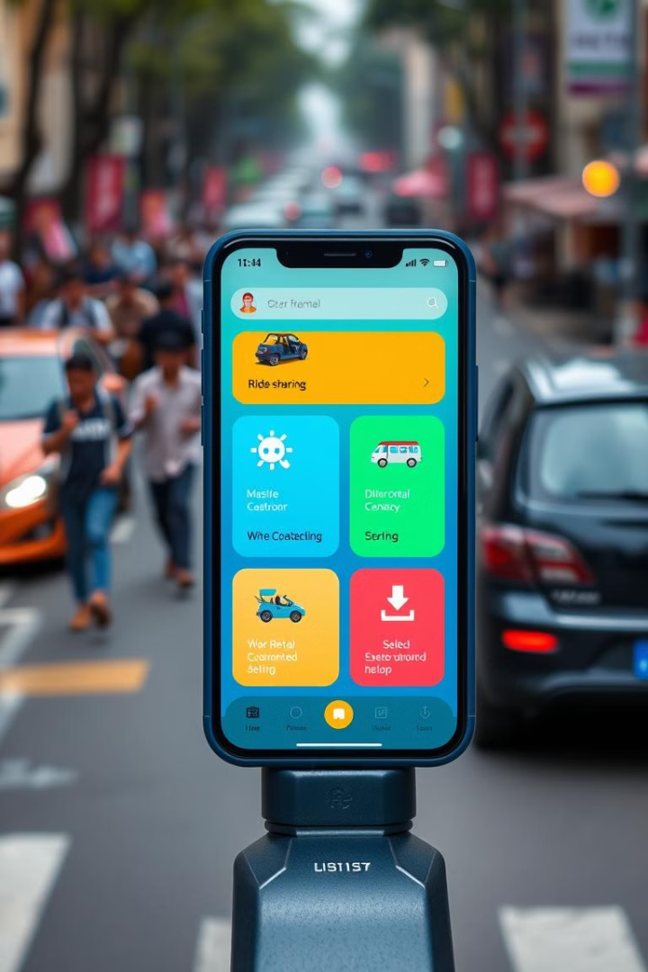
Trends in On-Demand Services
1
Increased Demand
The demand for on-demand services continues to rise, driven by factors such as convenience, affordability, and accessibility. This presents a significant opportunity for platforms like Drive on Demand.
2
Technological Advancements
Advancements in mobile technology, GPS, and real-time communication have paved the way for the development of sophisticated on-demand platforms. These technologies are crucial for the functionality of Drive on Demand.
3
Shifting Consumer Preferences
Consumers are increasingly seeking flexible and personalized experiences. This shift in preference is driving the adoption of on-demand services and fuels the growth potential of Drive on Demand.

Slide 4

Objective of the Project
The primary objective of this project is to develop a robust, user-friendly, and feature-rich platform that enables users to easily book and access transportation services. The platform will facilitate a seamless and convenient experience for both users and service providers, fostering a thriving community for on-demand transportation.

Slide 5
Technology and Hardware Requirements
Development Environment
Server Requirements
Client Requirements
A powerful computer with a multi-core processor, sufficient RAM, and a fast SSD drive is recommended for efficient development and testing. The developer environment should include a code editor or IDE with support for JavaScript, React, Node.js, MongoDB, and related tools.
The platform will require a reliable server with sufficient processing power, storage space, and bandwidth to handle user traffic and data storage. A cloud-based hosting solution like AWS or Azure offers scalability and flexibility for accommodating future growth.
Users will need a modern web browser and a stable internet connection to access and utilize the Drive on Demand website. The platform should be optimized for both desktop and mobile devices to provide a seamless experience across platforms.

Slide 6

Software Requirements
Category
Software
Description
Languages
JavaScript
For both frontend (React) and backend (Node.js) development
Frontend Framework
React.js
For creating the user interface, providing a robust and efficient architecture
Backend Framework
Express.js
For handling server-side logic and API endpoints, enabling efficient communication
Database
MongoDB
For storing user data, vehicle information, bookings, and other essential information
Version Control
Git
For managing code changes, tracking progress, and collaborating with other developers

Slide 7

Key Modules of the Drive on Demand Website
User Authentication
Service Management
This module handles user registration, login, and profile management. It ensures secure access and safeguards user data.
This module manages the listing of available services, including vehicle types, pricing, and availability. It enables service providers to register and update their information.
Booking and Payment
Real-time Tracking
This module handles the booking process, including selecting a service, specifying pickup and drop-off locations, and facilitating secure payment processing.
This module allows users to track the location of their booked service in real-time, providing transparency and peace of mind.

Slide 8





Workflow and User Journey
User Registration/Login
New users can register for an account, while existing users can log in to access the platform.
Service Selection
Users can browse available services, including vehicle types, pricing, and availability, based on their location and preferences.
Booking
Users can book a service by specifying pickup and drop-off locations, choosing a preferred time, and confirming their details.
Real-time Tracking
Users can track the location of their booked service in real-time, providing visibility and peace of mind.
Payment and Completion
Users can securely pay for their booked service and receive confirmation upon completion of the ride.

Slide 9




Project Reports
Goals
The project reports will document the project goals, including key performance indicators (KPIs) related to user acquisition, service utilization, and overall platform satisfaction.
Technical Details
Detailed technical specifications, including code structure, database design, API endpoints, and security measures, will be documented for reference and future development.
Hardware
The reports will outline the hardware requirements, including server specifications, database configuration, and network infrastructure, ensuring a reliable and scalable platform.

